Slide 1

Investment Analysis
Exploring potential investment opportunities to invest in restaurants in Mexico
Prepared by
Khin Moet Moet Nyein (Kay)
Last updated on
2021-09-15
This analysis is completed as part of Google Analytics Certificate program, capstone project.

Slide 2



//02
Contents
01
03
03
04
Executive Summary
Business Objectives
Datasets
Findings
05
06
07
Recommendations
Limitations
Appendix

Slide 3
Key Business Task
To discover the interesting pattern and trend in restaurant market in different Mexican cities in order to help make investment decisions.
//03
Notes:
As an analyst working in the firm that invests in new restaurant opportunities abroad, the abovementioned business task is being assigned. Key stakeholders will be the management board who collectively decide on the investment decisions.

Slide 4
01
Executive
Summary

Slide 5
//05
Key findings
Main consumer segment meets the following criteria.
Student
Age between 18-25
Not married
On medium budget
Restaurants are located where the consumers are.
Lesser restaurants that serve Mexican cuisine, in comparison to the demand.
Executive
Summary
Recommendations
Mexican franchise restaurants are recommended.
Pizzeria could also be put under consideration.
Open seating area and easy access to public transport should be in consideration.
Limitations
The sample population is relatively small and there could be presence of sampling bias.

Slide 6
02
Business
Objectives

Slide 7



Demographic
Business Objectives
To uncover the demographic details of the consumer.
Consumer profiling
Lifestyle
To explore the lifestyle of the consumer.
Geographic
To discover the geograhical presence.
Preference
//07
To explore likes and dislikes of the consumers.

Slide 8
03
Datasets

Slide 9
Datasets
Include the rating provided by the consumer to each restaurant.
Include the preferred type of cuisine of the consumer.
CONSUMER
PREFERENCES
RESTAURANT
CUISINE
CONSUMER
RESTAURANTS
RATINGS
Cover the demographical and geographical details of the consumer in addition to lifestyle details.
Cover the geographical details of the restaurant in addition to aerial details.
Contains which type of food each restaurant serves.
//09
Notes:
This collection of datasets is hosted on Maven Analytics (https://www.mavenanalytics.io/data-playground) under the name "Restaurant Ratings". Completed data dictionary can be found at the appendix. On top of the datasets mentioned, population data from statisca (https://www.statista.com/) is used as the reference data.

Slide 10
At a glance
138
4
Consumers
Cities
130
3
Restaurants
States
//10

Slide 11
04
Finding: Consumer
Profiling

Slide 12
Occupation
Consumer Profiling
Student
Student
120
87%
Employed
16
Unemployed
2
Demographic
Age Group
Age 18-25
18-25
110
80%
26-35
16
36-45
2
56-65
1
65+
9
46-55
0
Based on the findings, a typical consumer is a
student,
is of age between 18-25, and
is single.
Marital Status
Single
Single
128
93%
Married
10
//12

Slide 13
Budget
Type of commute
Consumer Profiling
High
3.6%
On foot
10.1%
Low
25.4%
Car
25.4%
Lifestyle
Public
64.5%
Medium
71%
Smoker
Drink level
Based on the findings, a typical consumer
is on medium budget,
commutes on public transport,
non-smoker and
drinks moderately.
Smoker
18.8%
Social drinker
29%
Abstemious
37%
Non-smoker
81.2%
Casual drinker
34.1%
//13

Slide 14
//14
Consumer Profiling
San Luis Potosi
86
San Luis Potosi
84
Geographic
Consumer population is at where the restaurants are. Both charts that mapped no of consumers and no of restaurants by state are almost identical.
Morelos
27
Tamaulipas
25
Morelos
23
Tamaulipas
23
No of consumers by state
No of restaurants by state

Slide 15
//15
Consumer Profiling
Consumer Preferences
Restaurant
Cuisine
Other
26.1%
Mexican
28.4%
Preferences
Other
45.3%
Family
2.9%
Pizzeria
3.6%
Mexican
63%
American
4.3%
Bar
13.7%
Majority of consumers said to prefer Mexican cuisine whereas only a quarter of the restaurants serves Mexican. On average, the restaurants that serve Mexican, American, fast food are rated average (0=Unsatisfactory, 1=Satisfactory, 2=Highly Satisfactory).
Fast food
6.3%
Cafeteria
6.3%
1
0.75
0.5
0.25
0
American
Bar
Cafeteria
Fast Food
Mexican
Pizzeria

Slide 16
05
Recommendations

Slide 17
Who?
Student
Age 18-25
Not married
Medium-low budget
Target segment is students, age between 18-25, not married, on a medium to low budget.
Where?
San Luis Potosi
84
Tamaulipas
3.67
San Luis Potosi
102
Tamaulipas
108
Morelos
2.83
Morelos
23
Tamaulipas
23
San Luis Potosi
1.99
Morelos
60
It's recommended to focus on Tamaulipas where both the population and the number of high institutions are the highest amongst the three states.
No of restaurants
Total population in millions
No of higher education institutions
What?
Mexican is the preferred cuisine of the consumer.
Fast food franchise chains including Mexican, as well as burger and pizza are recommended as they are generally popular amongst students. Especially, there isn't any low-priced pizzeria and that could be fairly low hanging fruit.
The presence of open area seating is recommended to accommodate this pandemic age.
Parking area is good to have although it's not essential, however it's important to be in area easily accessible by the public transport..
63% of consumers prefer Mexican
28% of restaurants serves Mexican
Recommendations
Notes:
Population reference - https://www.statista.com/statistics/1036169/total-population-mexico-state/
Higher Institution reference - https://www.statista.com/statistics/706127/higher-education-institutions-mexico-state/

Slide 18
06
Limitation

Slide 19



//19
Sampling bias
Questionnaire
Cofidentiality
There could be the presence of sampling bias in the dataset as almost 90% of the respondents are students.
It's critical that the wording in questionnaire is clear and the flow must be well thought out. For example, For the question that asks how many children does the respondent has, 90% of the responses are "independent". The response could have intendend to say the respondents him/herself is independent, not that they have independent kids.
It'd be critical to have the answer for the question, "How confident are we that the respondent would be willing to share about budget information?" It's likelier that the respondents would be more honest to answer the question at a more private setting, in comparison to the street survey.
Datasets

Slide 20
07
Appendix

Slide 21
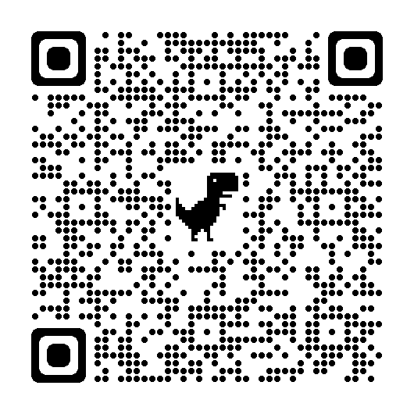
//21
Appendix
This QR code is the link to the spreadsheet (google sheet) where data manipulation work is done. In addition, it contains the following under "Read Me" page.
Reference links
Table mapping within the spreadsheet
Documentation of data manipulation.

Slide 22
Contact Information
//22
EMAIL ADDRESS
kmmnyein25@gmail.com
LINKEDIN
linkedin.com/in/khinmoetmoetnyein/
FOR QUESTIONS OR COMMENTS
GITHUB
github.com/kmmnyein25/
KAGGLE
kaggle.com/kmmnyein25

